Slide 1
Snapper nursery habitat movement patterns inform us about anthropogenic environmental disruptions
Armagan Sabetian (PhD James Cook University)
Department of Applied Ecology,
Auckland University of Technology

Slide 2




Conception
Full team: Armagan Sabetian, Jingjing Zhang, Matthew Campbell, Richard Walter, Hamish Allen, Malcolm Reid, Kavindra Wijenayake, Julian Lilkendey

Slide 3
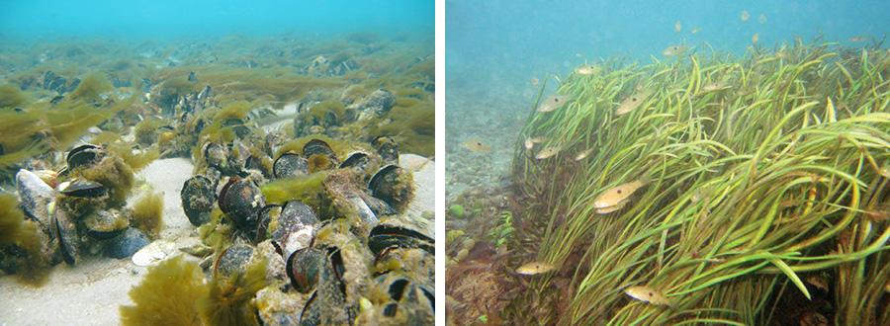
Snappers are functionally dependent on coastal estuarine habitats as nursery areas
Images: Ian McLeod, Crispin Middleton

Slide 4
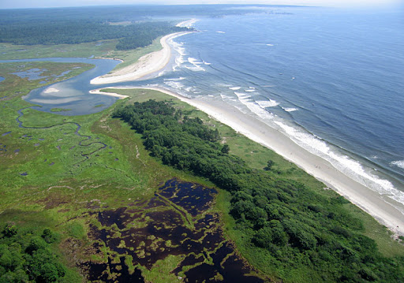
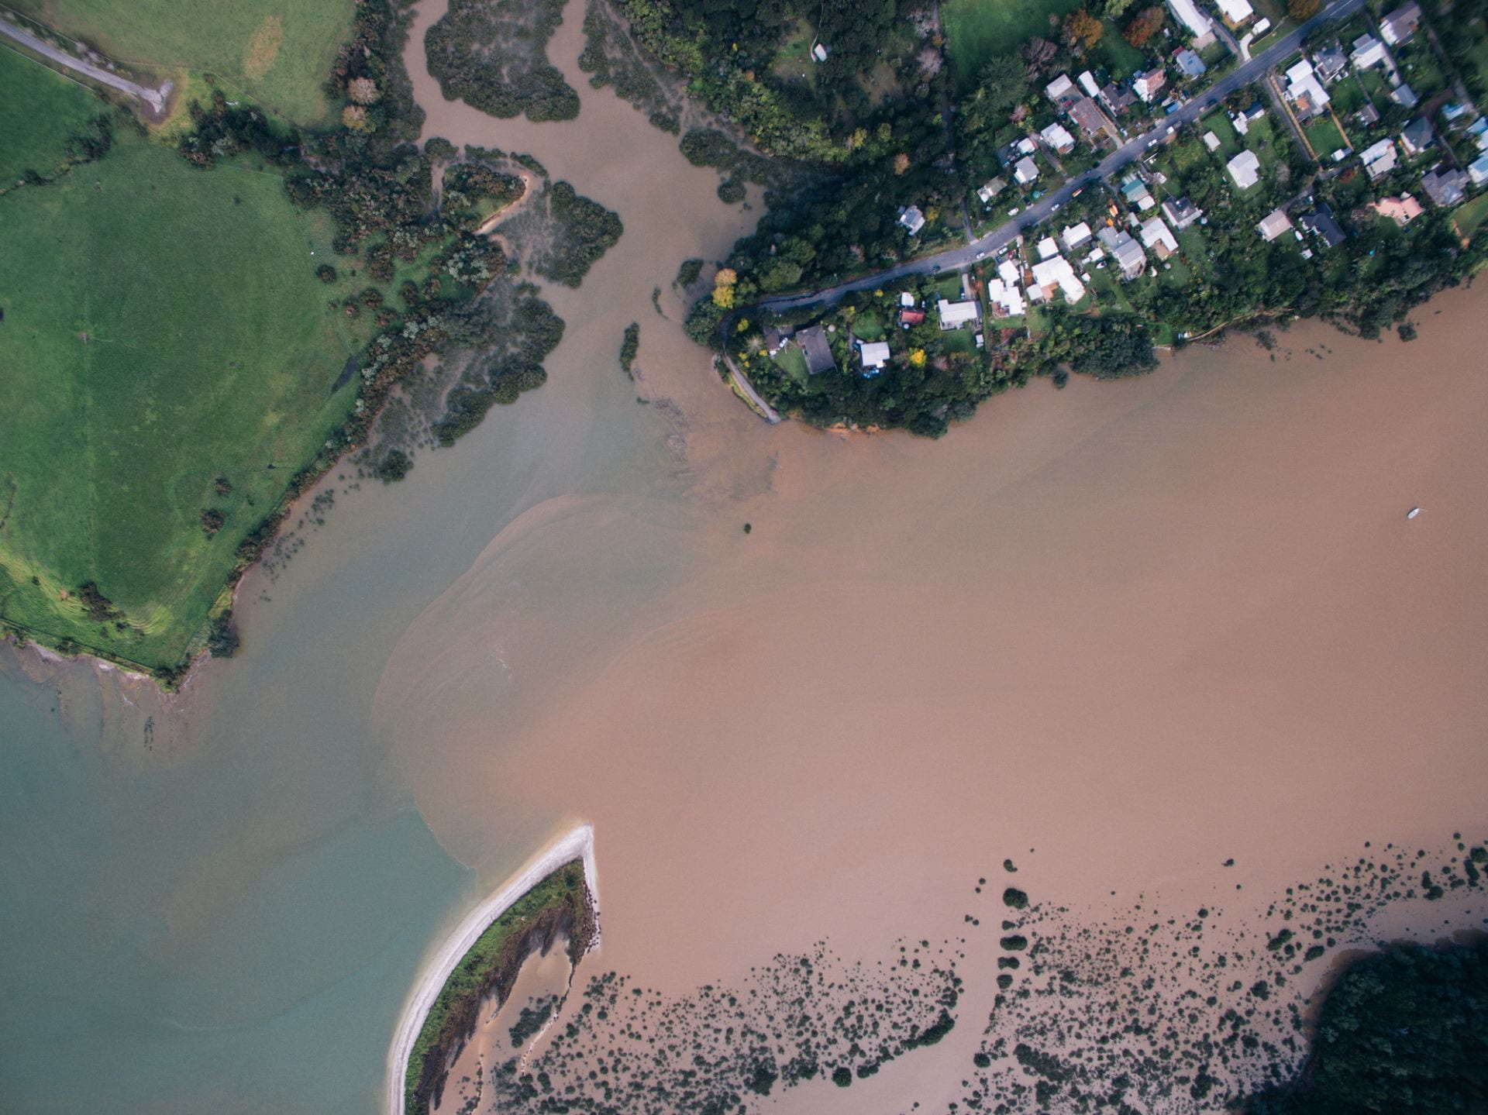
Modern human disturbances have resulted in degradation of Hauraki Gulf coastal habitats
Sediment plume Karepiro bay, near Longbay
Image: Geoff Reid

Slide 5
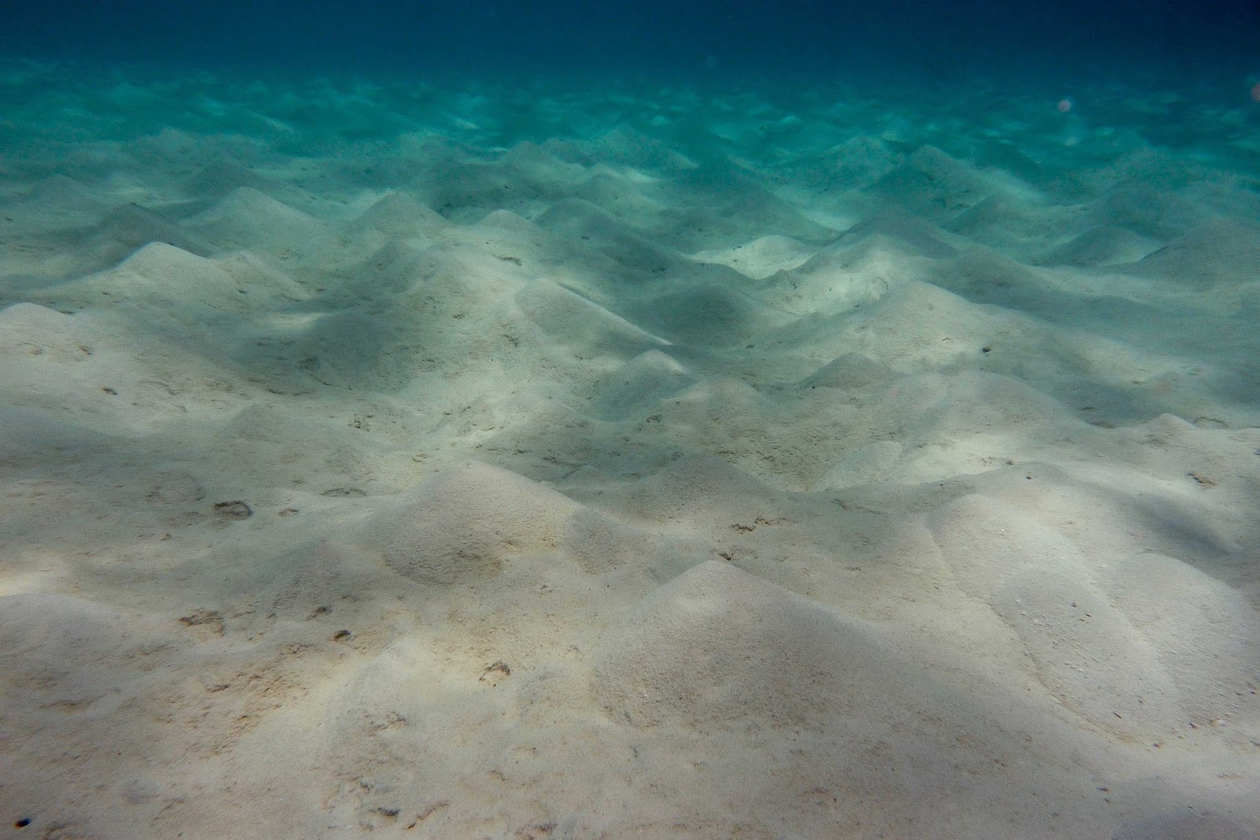
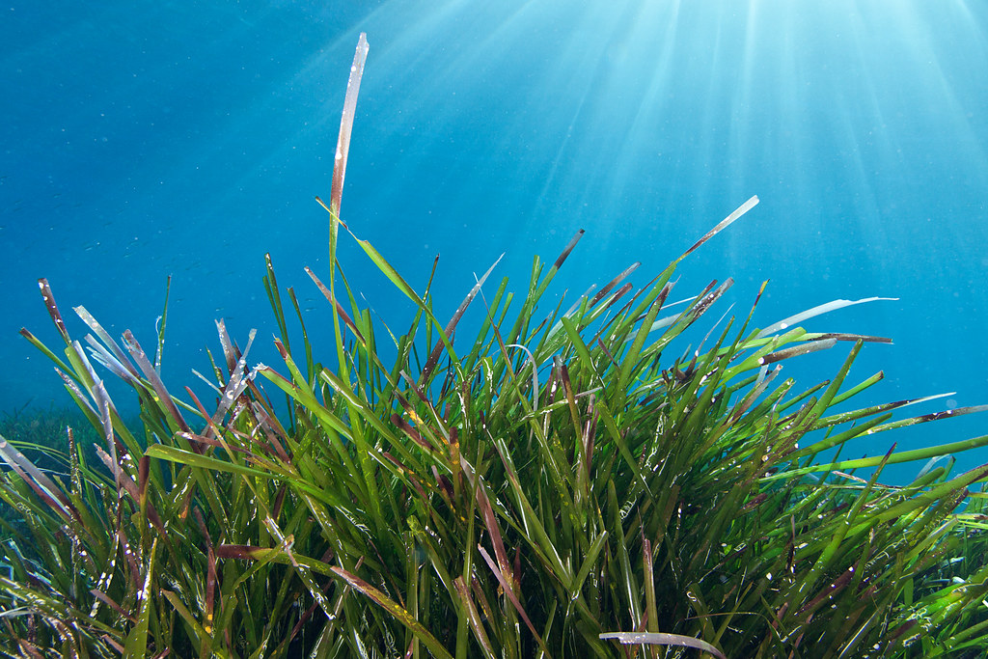
Our hypothesis was that the nursery characteristics of historical nearshore habitats will differ from those of today's

Slide 6
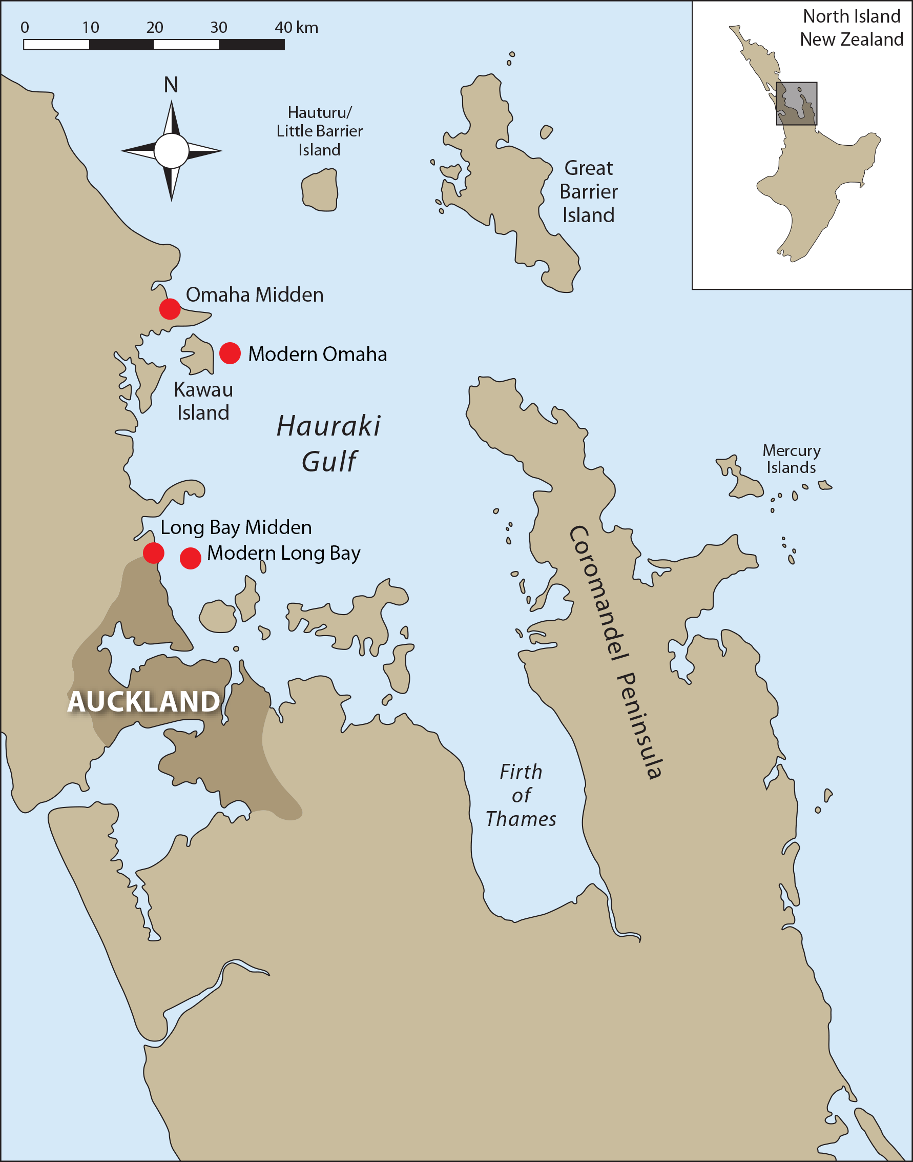
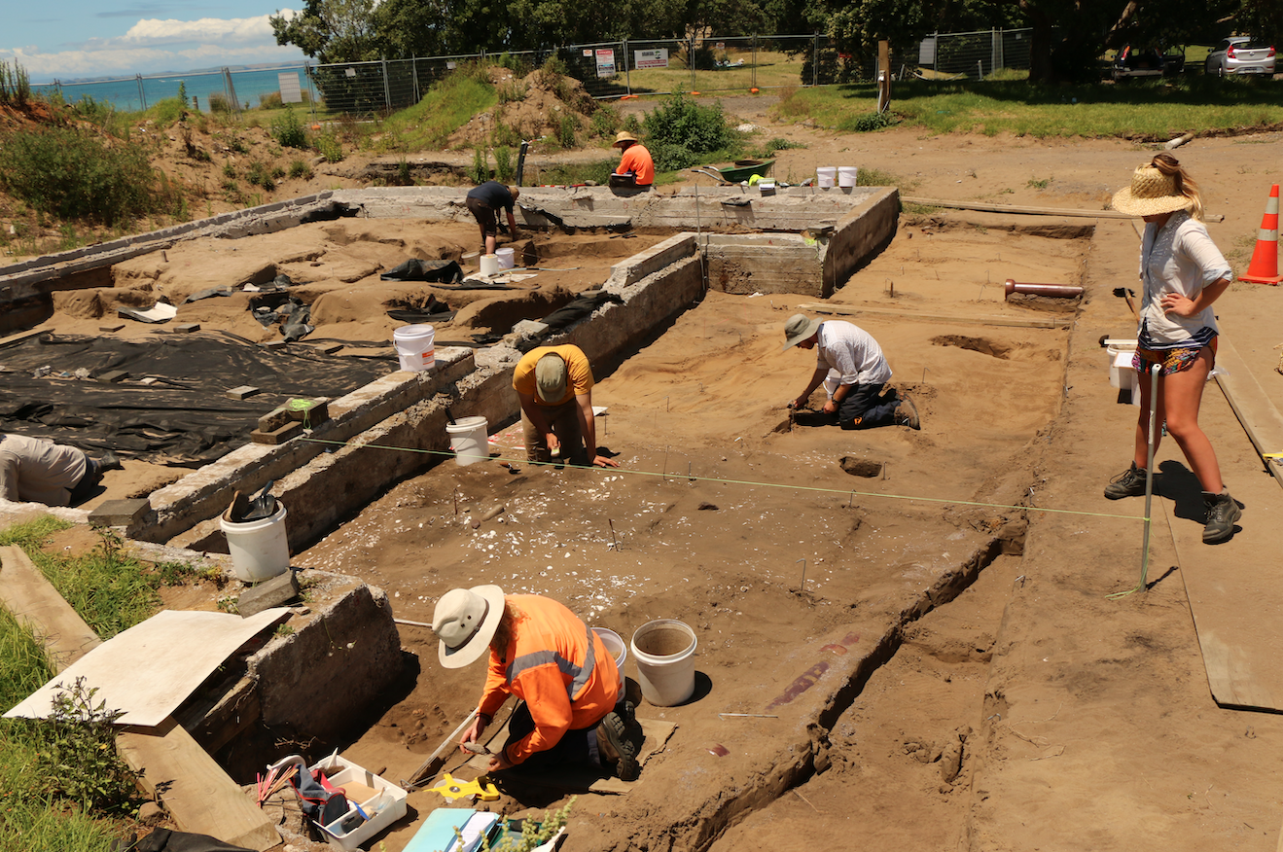
Omaha AD 1530-1640
Longbay AD 1430-1485
Omaha AD 2016
Longbay AD 2020
Laser ablation inductively coupled plasma mass spectrometry
(LA-ICP-MS)
Strontium, Barium
1100 µm (2 yr old snapper) compared across all samples

Slide 7
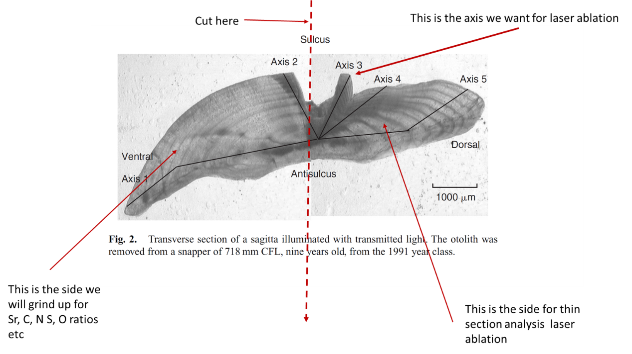
Status quo in otolith chemistry

Slide 8
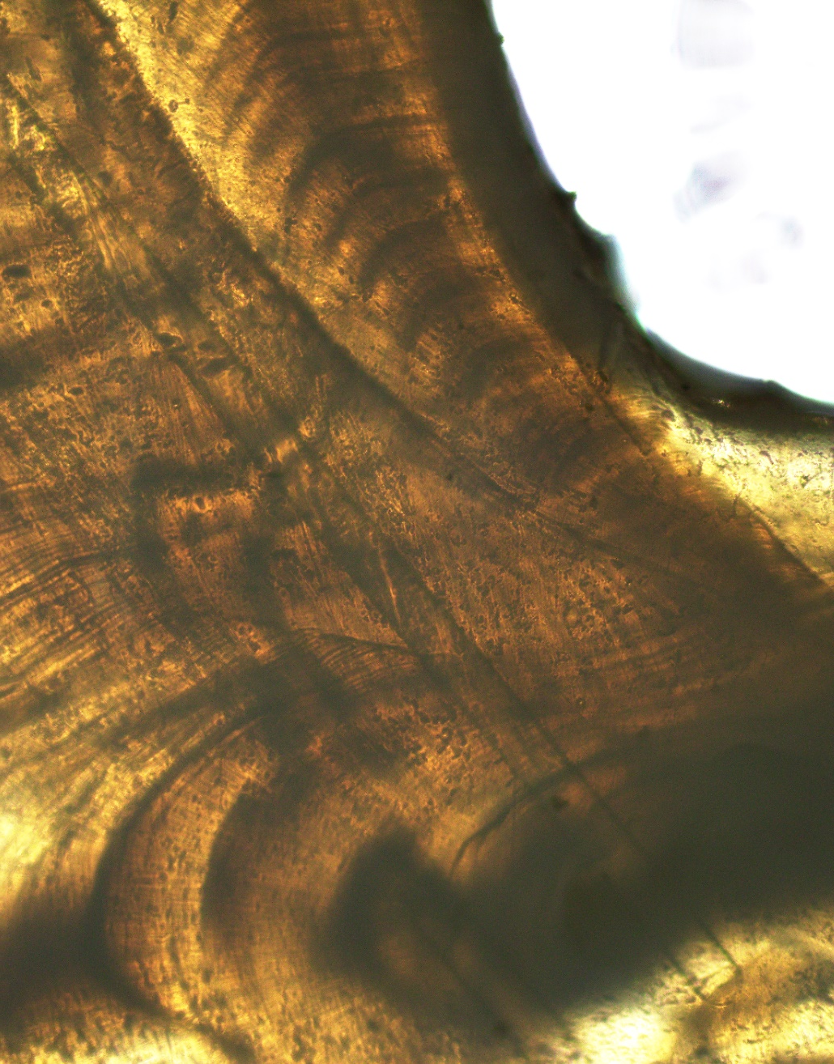
Status quo in otolith chemistry (laser ablation)
Sr
Ba
Sr
Ba
Sr

Slide 9
Status quo in otolith chemistry (analysis)
Marine
Sr [ppm]
Ba [ppm]
Distance [µm]
Riverine

Slide 10
Inferences about concentrations affected by physiology and time
We had to overcome the age range of middens spread across many decades. Which meant that the concentration of our elements would have been affected by environmental variables such as seawater temperature.
Furthermore, concentrations of elements can also be affected by metabolism and physiology of fish. Which is especially a problem in the status quo of otolith chemistry.

Slide 11
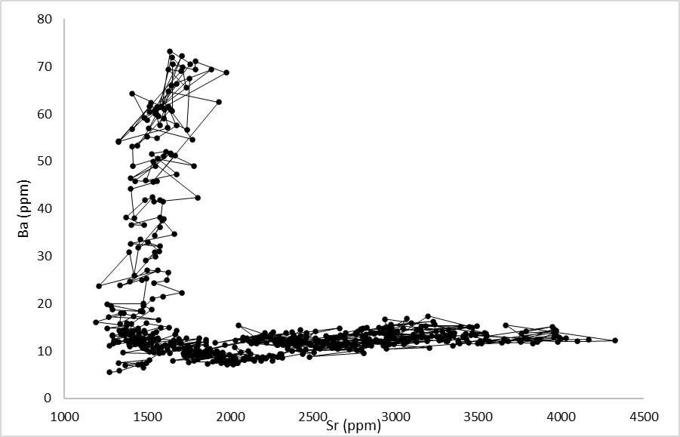
An opportunity for novel analysis?
Time-series analysis overcomes the problem of temporal autocorrelation we found in our data

Slide 12
What if we didn’t worry about absolute value?
By combining Behavioural Change Point Analysis (BCPA) with k-means clustering, we were able to cluster otolith element transect information into three distinct environments experienced by individual fish.
Riverine: High Ba (18.2 ± 0.3 ppm) and low Sr (1,717 ± 5 ppm);
Estuarine: Low Ba (8.01 ± 0.11 ppm) and medium Sr (1,767 ± 4 ppm);
Marine: Low Ba (9.38 ± 0.13 ppm) and high Sr (2,603 ± 6 ppm).

Slide 13
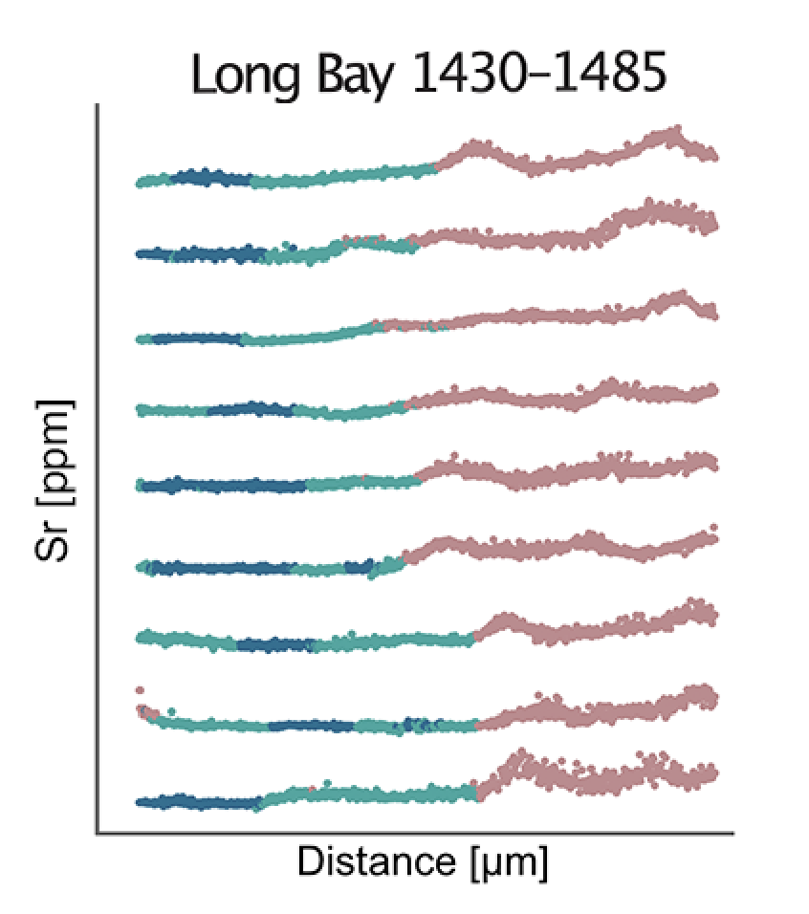
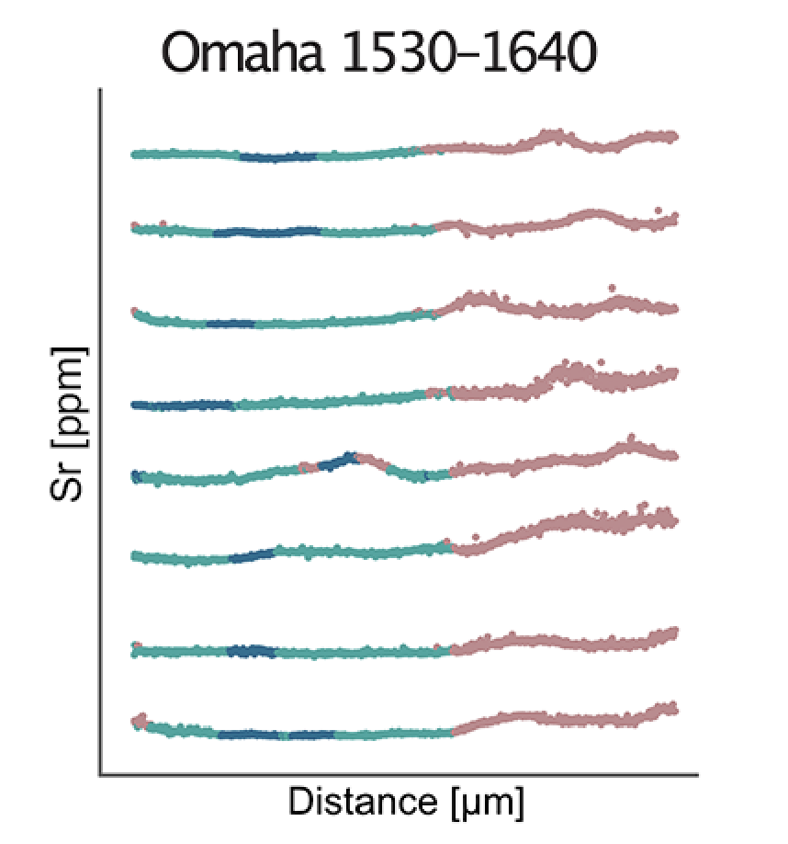
Estuarine, Riverine, Marine
Cluster succession very synchronised and homogenous

Slide 14
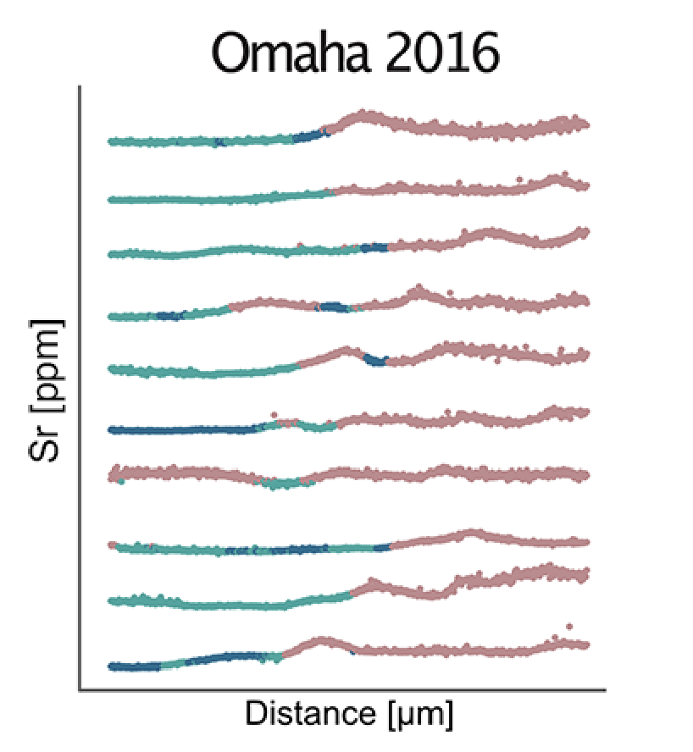
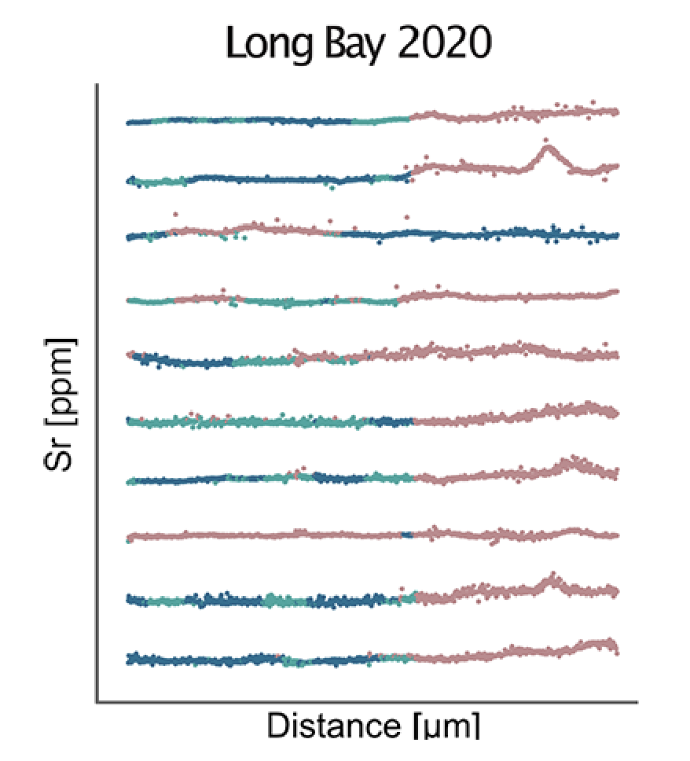
Estuarine, Riverine, Marine
Cluster succession chaotic and heterogenous
Notes:
Modern day snapper are very chaotic in their movement pattern, residency in different habitats at the same age, and transitions back and forth.

Slide 15
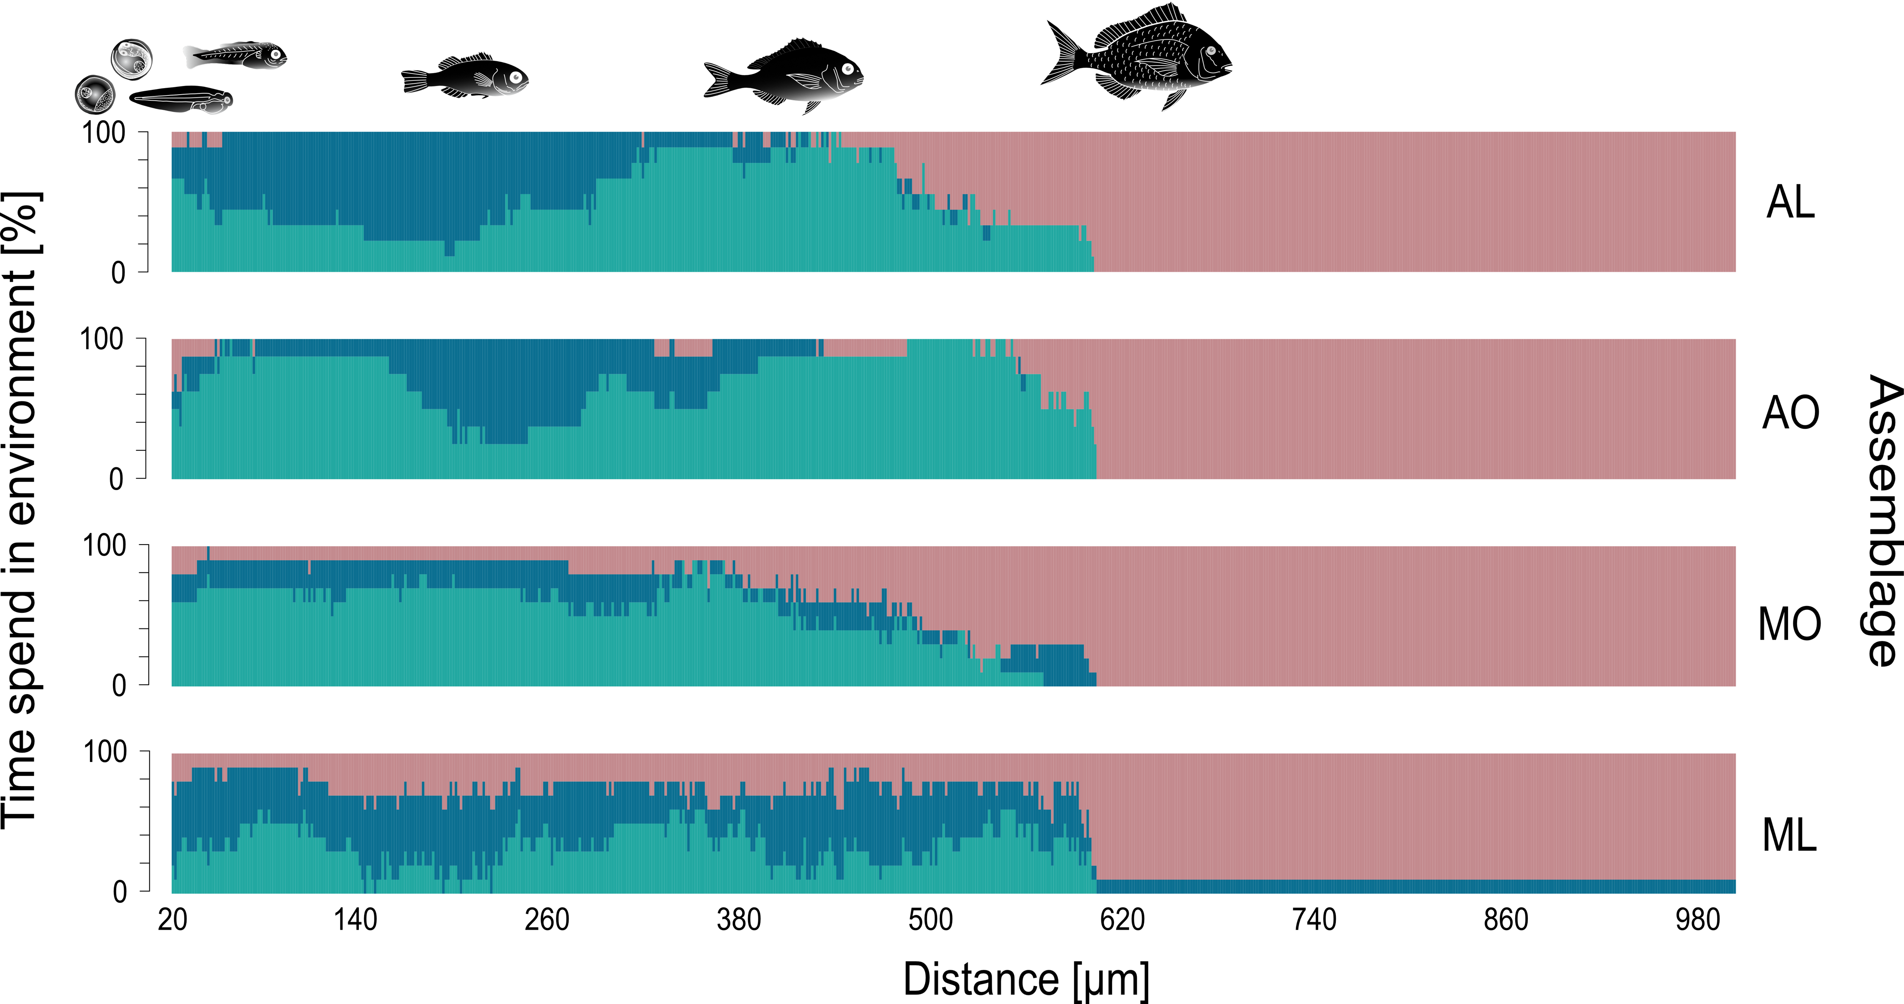
Proportion of the activity in each habitat
The mean proportion of habitat types (Estuarine = Green, Riverine = Blue, Marine = Light Red) identified by behavioural change point analysis with k-means clustering against the laser-ablated distance (core to edge) on the otoliths of New Zealand snapper Chrysophrys auratus by assemblage
Notes:
If we put all the samples together and looked at the overall proportion of their activity in each habitat you clearly see the estuarine habitat featured more prominently in archaeological samples, whereas in the modern samples the marine environment features prominently in the very early life stages.

Slide 16
Estuaries were important in the past
Archaeological snapper otoliths exhibited a synchronised movement pattern, while present-day appeared to be more asynchronous with snapper at the same life stage being in different habitats.
Archaeological snapper exhibited a higher proportion of estuarine habitat signature.

Slide 17
Estuaries don’t feature as much today
The proportion of the marine signature was significantly higher in present day snapper.
The total number of transitions between habitats was highest in modern day snapper.
Notes:
The total number of transitions between habitats was highest in the transects of ML otoliths (31.8 ± 3.38 transitions transect⁻¹), and differed significantly from the ones of the other three assemblages (Tukey HSD, all p < 0.001).
ML otoliths exhibited significantly more transitions between estuarine and riverine (Welch's Heteroscedastic F Test, F_{(1, 13.9)} = 4.71, p < 0.05) as well as between riverine and marine environments when compared to their conspecifics from archaeological middens

Slide 18
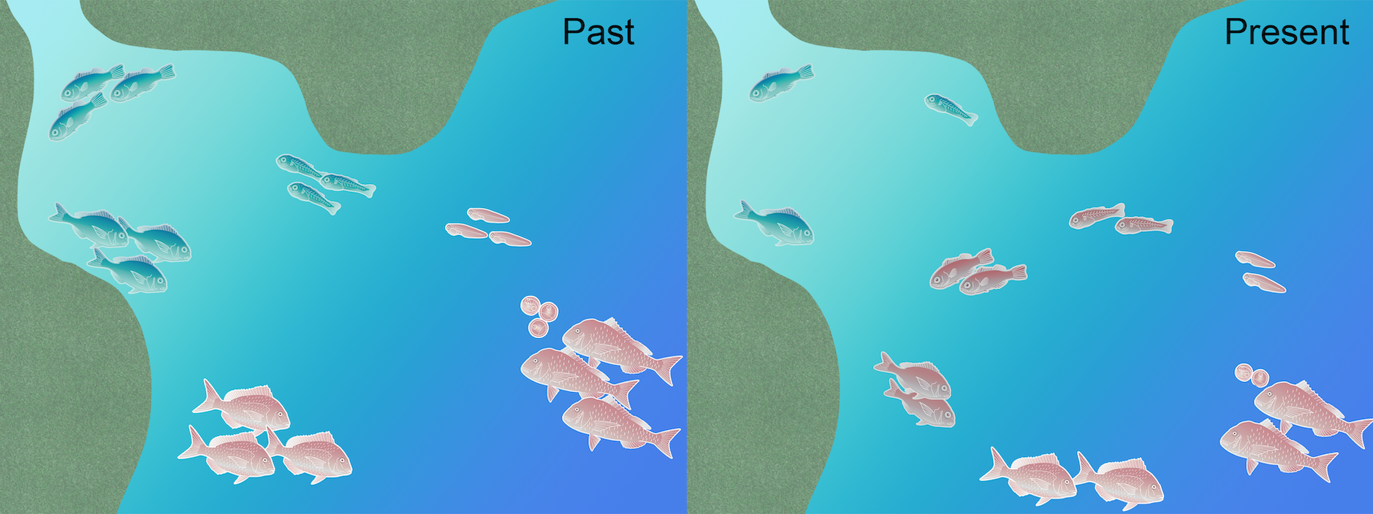
Conclusions
Synchronised ontogenetic shifts vs Asynchronised ontogenetic shifts
Notes:
Modern day Hauraki Gulf snapper don’t use estuarine habitats as much as historical conspecifics. Well time ontogenetic shifts.
Reasons, clearly anthropogenic effects and degradation of nursery habitats.

Slide 19
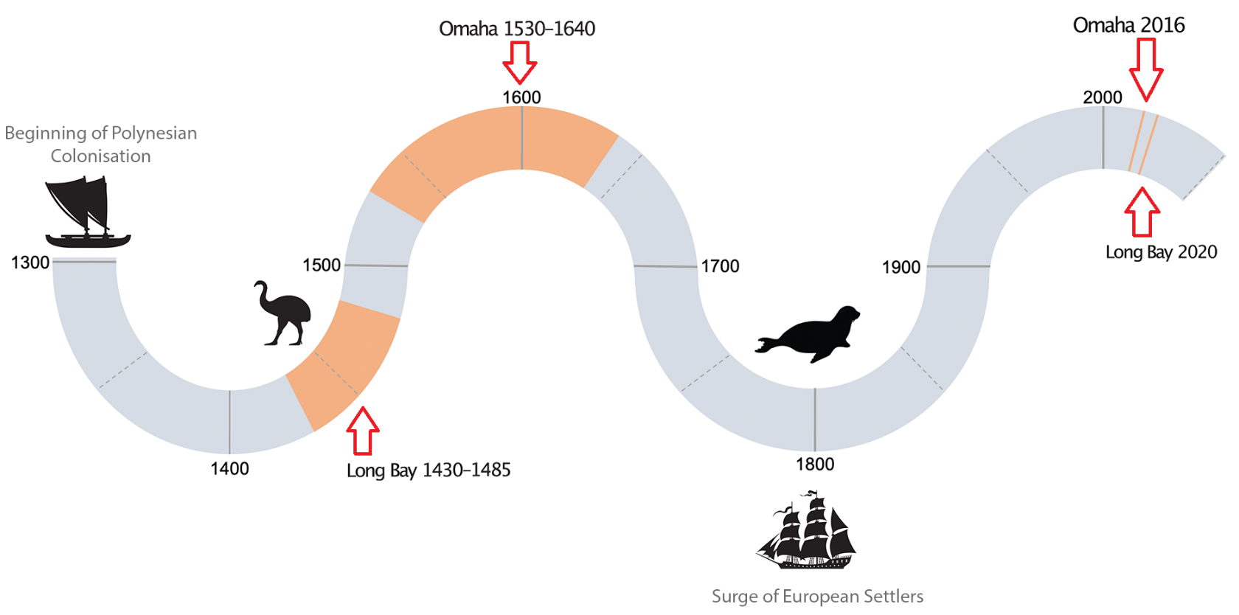
Omaha 1530 - 1640
Omaha 2016
Long Bay 2020
Long Bay 1430 - 1485
Notes:
Maori didn’t appear to have significant impact on snapper ontogeny, or coastal degradation. Two cool things here, samples chosen were anywhere within those time ranges, but they still were extremely choreographed in their movements, even though separated by centuries.

Slide 20
Clearly, nursery habitats were an important ecosystem for juvenile snapper in the past, to the point that their movement into these habitats after settlement was evidently choreographed.
What this study has shown is the clear association and dependency of snapper in the Hauraki Gulf on nursery habitats in a finer spatiotemporal scale in the past, elevating the knowledge-base in this space with high resolution quantitative data.
First year residency in nursery habitat is now confirmed.

Slide 21
There is an argument that the Hauraki Gulf, being a protected embayment, is acting as a pseudo-nursery.
But the observed lack of time spent in brackish nursery environments is indicative of a disrupted habitat use pattern during ontogeny which likely confers slower growth and condition, higher mortality, and ultimately lower recruitment chances to present-day individuals

Slide 22
Other questions that have arisen
When did nursery habitat-use of snapper change?
  Another look at Longbay’s unique stratification
  1950s/60s born snapper

Slide 23
Can we identify different nursery habitats within the same population and investigate aspects of stock connectivity?
    Doubtless Bay vs Hauraki Gulf

Slide 24
New questions
Can we identify other anthropogenic influences? Pollution, heavy metals, sedimentation etc..
  Fish/Bivalves?

Slide 25
Our main achievement & future application
We have been able to address the high interindividual variability of otolith chemistry data by simply looking at their behaviour and trajectory.
We have been able to use a proxy (snapper) to infer habitat quality
We now can apply this methodology to assess the efficacy of coastal habitat restoration initiatives

Slide 26
Thank you!
Happy to answer any questions.
Contact details:
  armagan.sabetian@aut.ac.nz
  julian.lilkendey@icloud.com
  jingjing.zhang@aut.ac.nz
  richard.walter@otago.ac.nz

